Slide 1
Intro to Time Series lecture-9 Course on Machine Learning on Spatio-Temporal Graphs (Summer Term 22)
Prof. Dr. Holger Giese (holger.giese@hpi.uni-potsdam.de)
Christian Medeiros Adriano (christian.adriano@hpi.de) - “Chris”
Matthias Barkowsky (matthias.barkowsky@hpi.de )
Iqra Zafar (iqra.zafar@hpi.de)

Slide 2
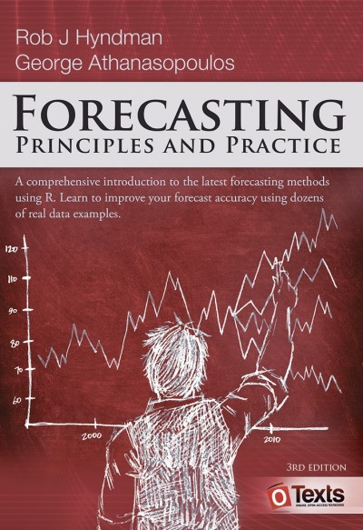
Index and Bibliography
Free PDFs available at: https://djsaunde.github.io/read/books/pdfs/probabilistic%20graphical%20models.pdf
Time Series
Markov Property
Non-Stationarity
https://otexts.com/fpp3/

Slide 3
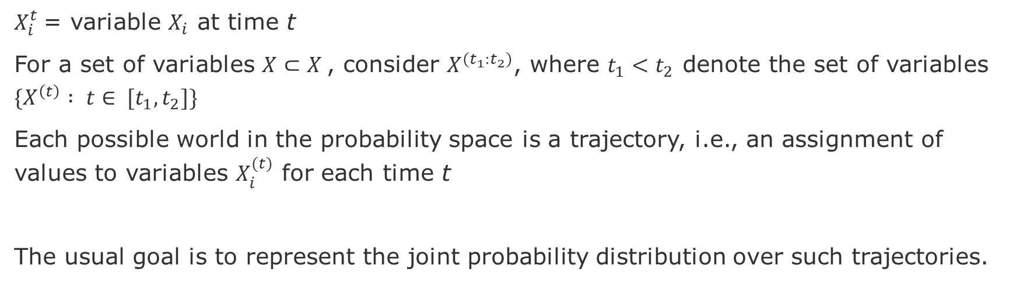
Time Series [Kohler & Friedman 2009]
$X_{i}^{t}$= variable $X_{i}$ at time t
For a set of variables $X⊂Χ$, consider $X^{{(t}_{1}:t_{2})}$, where $t_{1}<t_{2}$ denote the set of variables $\{X^{\left(t\right)} : t∈ [t_{1}, t_{2}]\}$
Each possible world in the probability space is a trajectory, i.e., an assignment of values to variables $X_{i}^{(t)}$ for each time t
The usual goal is to represent the joint probability distribution over such trajectories.

Slide 4
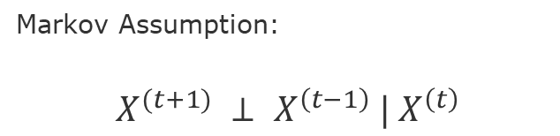
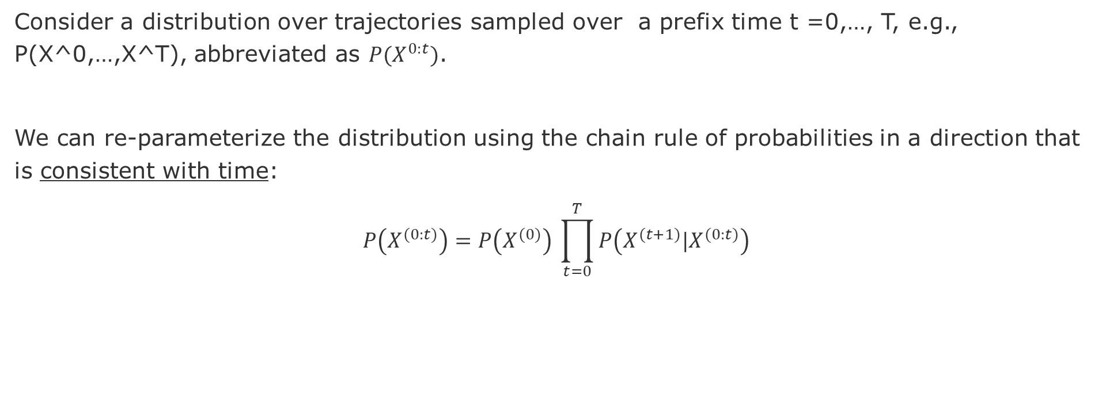

Basic Assumption
Consider a distribution over trajectories sampled over a prefix time t =0,…, T, e.g., P(X^0,…,X^T), abbreviated as $P(X^{0:t})$.
We can re-parameterize the distribution using the chain rule of probabilities in a direction that is consistent with time:
$$P\left(X^{(0:t)}\right)=P\left(X^{(0)}\right) \prod_{t=0}^{T}{P\left(X^{(t+1)}|X^{(0:t)}\right)}$$
The distribution over trajectories is the product of conditional distributions, for the variables in each slice of time given the preceding ones.
Markov Assumption:
$$X^{(t+1)} ⊥ X^{\left(t−1\right)} |{ X}^{\left(t\right)}$$
Dynamical systems that satisfy the Markov assumption are called Markovian
$$P\left(X^{(0:t)}\right)=P\left(X^{(0)}\right) \prod_{t=0}^{T−1}{P\left(X^{(t+1)}|X^{(t)}\right)}$$

Slide 5
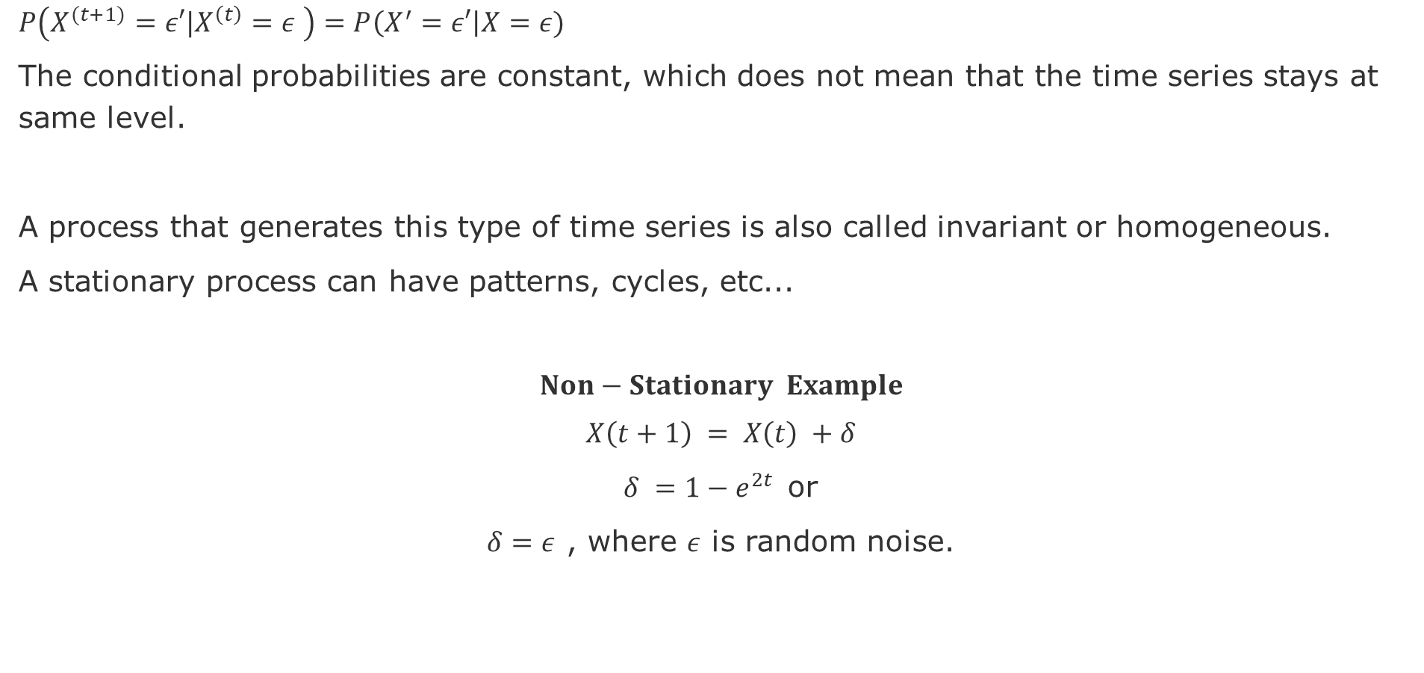
Stationary Time Series
$P\left(X^{(t+1)}=ε′|X^{\left(t\right)}=ε \right)=P\left(X^{′}=ε′\right|X=ε)$
The conditional probabilities are constant, which does not mean that the time series stays at same level.
A process that generates this type of time series is also called invariant or homogeneous.
A stationary process can have patterns, cycles, etc...
$$Non−Stationary Example$$
$$X\left(t+1\right) = X\left(t\right) +δ$$
$δ ={1−e}^{2t}$or
$δ=ε$ , where $ε$ is random noise.

Slide 6
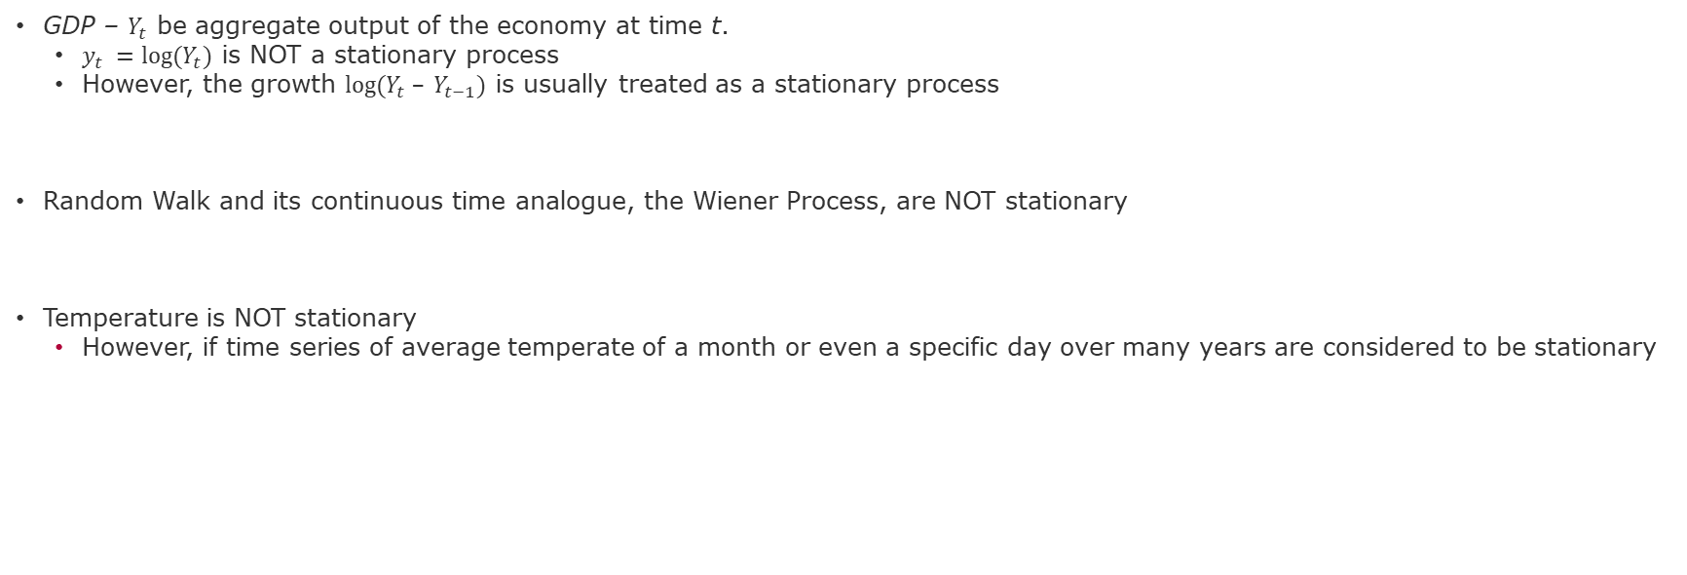
Stationary Processes Examples
GDP – $Y_{t}$ be aggregate output of the economy at time t.
$y_{t} =log⁡(Y_{t})$ is NOT a stationary process
However, the growth $log⁡(Y_{t} – Y_{t−1})$ is usually treated as a stationary process
Random Walk and its continuous time analogue, the Wiener Process, are NOT stationary
Temperature is NOT stationary
However, if time series of average temperate of a month or even a specific day over many years are considered to be stationary

Slide 7
Strict and Covariant Stationarity
A process is strictly stationary if the joint distribution is time invariant.
A process is covariance stationary if the unconditional expectation and the autocovariance exist and do not vary over time.
Strict stationarity does not imply covariance stationarity and covariance stationarity does not imply strict stationarity.

Slide 8
End

